Slide 1
Recurrent Neural Network

Slide 2
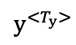
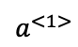
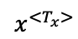
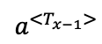
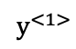
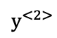
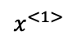
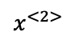
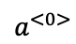
Why Recurrent Neural Network?
$$y^{<1>}$$
$$y^{<2>}$$
$$y^{<T_{y}>}$$
RNNs are designed to recognize a data's sequential characteristics and use patterns to predict the next likely scenario.
$$a^{<0>}$$
$$a^{<1>}$$
$$a^{<T_{x−1}>}$$
Applications:
NLP (e.g. text classification, Machine Translation, etc.)
Speech Recognition
Time Series Forecast (e.g. Financial Data)
…
$$x^{<1>}$$
$$x^{<2>}$$
$$x^{<T_{x}>}$$

Slide 3
Type of RNN
Standard RNN
Gated Recurrent Unit (GRU)
Long short-term memory (LSTM)
Bidirectional RNN
.

Slide 4
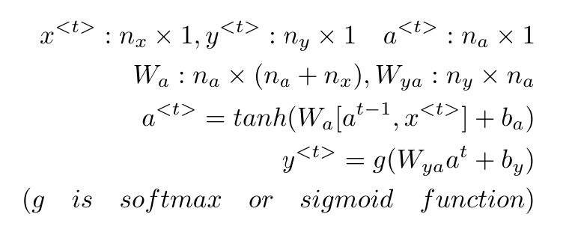
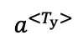
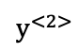
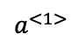
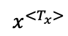
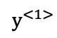
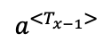
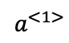
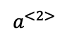
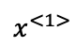
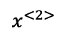
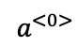
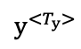
Standard RNN
$$y^{<1>}$$
$$y^{<2>}$$
$$y^{<T_{y}>}$$
Dense
Dense
Dense
$$a^{<1>}$$
$$a^{<2>}$$
$$a^{<T_{y}>}$$
$$a^{<0>}$$
$$a^{<1>}$$
$$a^{<T_{x−1}>}$$
RNN Unit
RNN Unit
…
RNN Unit
$$x^{<1>}$$
$$x^{<2>}$$
$$x^{<T_{x}>}$$

Slide 5
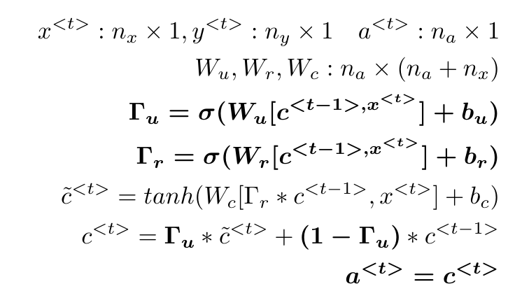
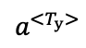
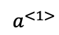
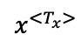
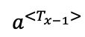
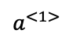
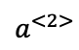
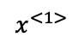
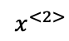
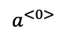
GRU
$$a^{<1>}$$
$$a^{<2>}$$
$$a^{<T_{y}>}$$
$$a^{<0>}$$
$$a^{<1>}$$
$$a^{<T_{x−1}>}$$
GRU
GRU
…
GRU
$$x^{<1>}$$
$$x^{<2>}$$
$$x^{<T_{x}>}$$

Slide 6
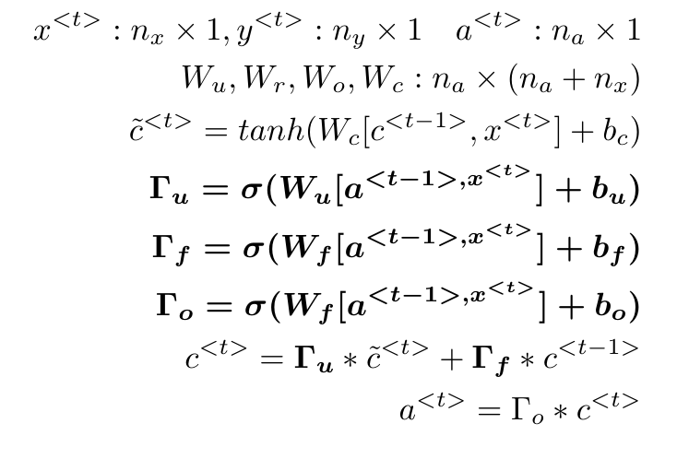
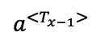
LSTM
$$a^{<1>}$$
$$a^{<2>}$$
$$a^{<T_{y}>}$$
$$a^{<0>}$$
$$a^{<1>}$$
$$a^{<T_{x−1}>}$$
LSTM
LSTM
…
LSTM
$$x^{<1>}$$
$$x^{<2>}$$
$$x^{<T_{x}>}$$
Generally, LSTM is more powerful than the others. But it is more computationally expensive!

Slide 7
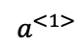
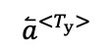
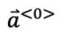
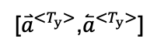
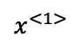
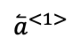
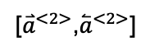
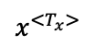
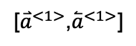
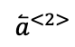
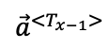
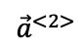
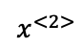
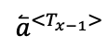
Bidirectional RNN
[${\overset{⃑}{a}}^{<1>}$,${\overset{⃐}{a}}^{<1>}$]
[${\overset{⃑}{a}}^{<2>}$,${\overset{⃐}{a}}^{<2>}$]
[${\overset{⃑}{a}}^{<T_{y}>}$,${\overset{⃐}{a}}^{<T_{y}>}$]
$$a^{<1>}$$
$${\vec{a}}^{<2>}$$
$${\vec{a}}^{<T_{x−1}>}$$
$${\overset{⃑}{a}}^{<0>}$$
LSTM
LSTM
…
LSTM
$${\overset{⃐}{a}}^{<T_{y}>}$$
$${\overset{⃐}{a}}^{<1>}$$
$${\overset{⃐}{a}}^{<2>}$$
$${\overset{⃐}{a}}^{<T_{x−1}>}$$
$$x^{<1>}$$
$$x^{<2>}$$
$$x^{<T_{x}>}$$

Slide 8
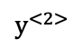
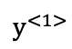




RNN For NLP
How to input words into RNN?
Word embedding (word2vec, GloVe algorithms)
2 applications in NLP:
Text classification (sentimental analysis)
Text generation
$$y^{<1>}$$
$$y^{<2>}$$
$$y^{<T_{y}>}$$
$$a^{<0>}$$
$$a^{<1>}$$
$$a^{<T_{x−1}>}$$
…
word1
word2
wordTx

Slide 9
Word Embedding
Dictionary: 40,000 words
One-hot encoding For Dictionary[i]= word_i
.
0
All words 40,000 x 40,000
All words 40,000 x 200
0…1
…
0
0
0
0
0
0
i th entry
Training words vectors
40,000

Slide 10


Word Embedding Training method: word2vec
Exp: I like playing computer game because it is a good way to relax my brain.
Target words : computer
Context words: playing, games
Skip-Gram Model
Continuous Bag-of-Word (CBOW)
Data: (x=computer, y=playing)
(x=computer, y=game)
Data: (x= playing, game y=computer)

Slide 11



Sentimental Analysis
$$y^{<T_{y}>}$$
$$a^{<0>}$$
$$a^{<1>}$$
$$a^{<T_{x−1}>}$$
…
$$e^{<1>}$$
$$e^{<2>}$$
$$e^{<Tx>}$$
Embedding
word1
word2
wordTx

Slide 12







Text Generalization Model
Data: （set window size as 3）
X=(I like playing computer game.)
I like playing computer game.
$$y^{<1>}$$
$$y^{<2>}$$
X | Y
I like playing | like playing computer
like playing computer | playing computer game
playing computer game | computer game.
$$y^{<T_{y}>}$$
$$a^{<0>}$$
$$a^{<1>}$$
$$a^{<3>}$$
$$e^{<1>}$$
$$e^{<2>}$$
$$e^{<Tx>}$$
Embedding
I
like
computer

Slide 13
Thank you.

